Slide 1
DISTRIBUTED SYSTEM Presentation By Genevia Nongrum Roll no: 21

Slide 2
Contents
Introduction
Advantages
Example of a Distributed Database
Implementation Issues
Disadvantages
References

Slide 3
Introduction
A distributed database (DDB) is a collection of multiple interconnected databases, which are spread physically across various locations that communicate via a computer network.
Distributed database management system(DDBMS) is a software system that manages a distributed database while making the distribution transparent to the user..

Slide 4
Distributed database system
In a distributed database system, the database is stored on several computers.
The computers in a distributed system communicate with one another through various communication media, such as high-speed networks or telephone lines.
They do not share main memory or disks.
The computers in a distributed system may vary in size and function, ranging from workstations up to mainframe systems.

Slide 5
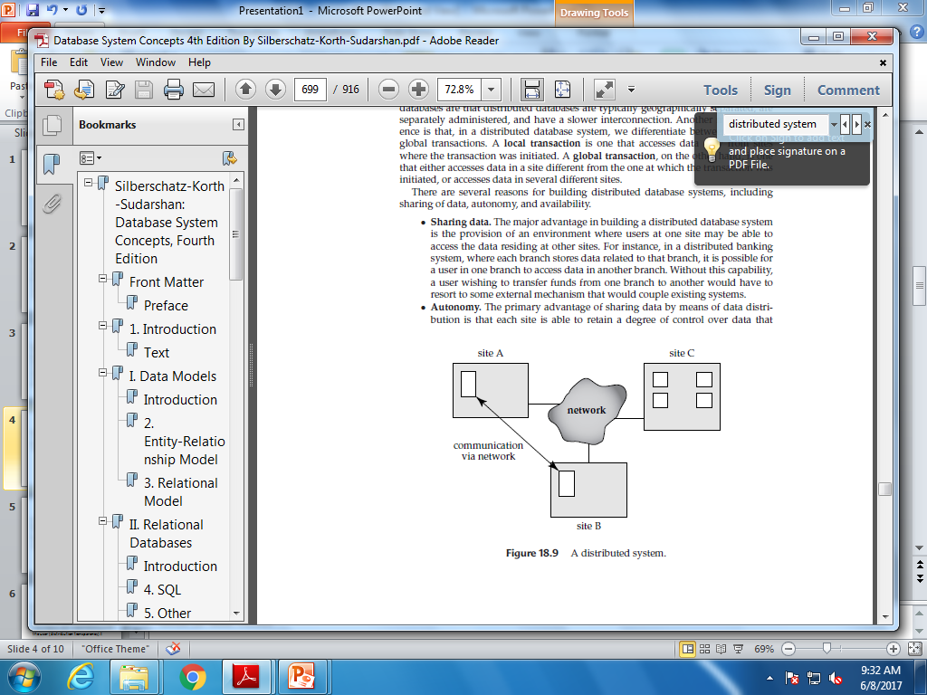
Distributed database system

Slide 6
Advantages
There are several reasons for building distributed database systems, including sharing of data, autonomy, and availability.
Sharing data.
The major advantage in building a distributed database system is the provision of an environment where users at one site may be able to access the data residing at other sites.
For instance, in a distributed banking system, where each branch stores data related to that branch, it is possible for a user in one branch to access data in another branch.
Without this capability, a user wishing to transfer funds from one branch to another would have to resort to some external mechanism that would couple existing systems.

Slide 7
Advantages (contd..)
Autonomy
The primary advantage of sharing data by means of data distribution is that each site is able to retain a degree of control over data that are stored locally.
In a centralized system, the database administrator of the central site controls the database. But in a distributed system, there is a global database administrator responsible for the entire system.
A part of these responsibilities is delegated to the local database administrator for each site. Depending on the design of the distributed database system, each administrator may have a different degree of local autonomy.
The possibility of local autonomy is often a major advantage of distributed databases.

Slide 8
Advantages (contd..)
Availability.
If one site fails in a distributed system, the remaining sites may be able to continue operating.
In particular, if data items are replicated in several sites, a transaction needing a particular data item may find that item in any of several sites.

Slide 9
An Example of a Distributed Database
Consider a banking system consisting of four branches in four different cities. Each branch has its own computer, with a database of all the accounts maintained at that branch.
There also exists one single site that maintains information about all the branches of the bank.
Each branch maintains (among others) a relation account(Account-schema), where
Account-schema = (account-number, branch-name, balance)
The site containing information about all the branches of the bank maintains the relation branch(Branch-schema), where
Branch-schema = (branch-name, branch-city, assets)

Slide 10
Implementation Issues
Atomicity of transactions is an important issue in building a distributed database system.
If a transaction runs across two sites, unless the system designers are careful, it may commit at one site and abort at another, leading to an inconsistent state.
The two-phase commit protocol (2PC) is the most widely used of these protocols.
Concurrency control is another issue in a distributed database.
If locking is used (as is almost always the case in practice), locking can be performed locally at the sites containing accessed data items, but there is also a possibility of deadlock involving transactions originating at multiple sites.
Therefore deadlock detection needs to be carried out across multiple sites.

Slide 11
Disadvantages
The primary disadvantage of distributed database systems is the added complexity required to ensure proper coordination among the sites.
This increased complexity takes various forms:
Software-development cost. It is more difficult to implement a distributed database system; thus, it is more costly.
Greater potential for bugs. Since the sites that constitute the distributed system operate in parallel, it is harder to ensure the correctness of algorithms,especially operation during failures of part of the system, and recovery from failures. The potential exists for extremely subtle bugs.
Increased processing overhead. The exchange of messages and the additional computation required to achieve intersite coordination are a form of overhead that does not arise in centralized systems.

Slide 12
References
Silberschatz−Korth−Sudarshan • Database System Concepts, Fourth Edition
Fundamentals_of_Database_Systems,_6th_Edition_(0136086209)

Slide 13
Thank You

